Slide 1
Generative AI-Driven Tumor Image Synthesis for Enhanced Prediction
Shreya Agarwal
Faculty Advisors: Dr. Daehan Won
Watson Institute for Systems Excellence
State University of New York at Binghamton
April 28th, 2025

Slide 2
Agenda
Methodology
Results
Next Steps

Slide 3
Segmentation Results with Original and Synthetic Tumors (1/2)
Applied Attention U-Net on LiTS dataset using Stratified K-Fold Cross-Validation, incorporating Sobel edge detection on all slices to enhance boundary precision and improve segmentation performance considering top 300 slices
Folds | Training Dice Coeff | Validation Dice Coeff | Sensitivity | Specificity
1 | 0.2 | 0.1 | 0.5 | 0.8
2 | 0.8 | 0.2 | 0.7 | 0.9
3 | 0.4 | 0.1 | 0.4 | 0.8
4 | 0.8 | 0.2 | 0.7 | 0.9
5 | 0.7 | 0.2 | 0.6 | 0.9
Avg. Accuracy | Avg. Dice | Exec Time
95.20 | 0.2 | 22199.06 sec

Slide 4
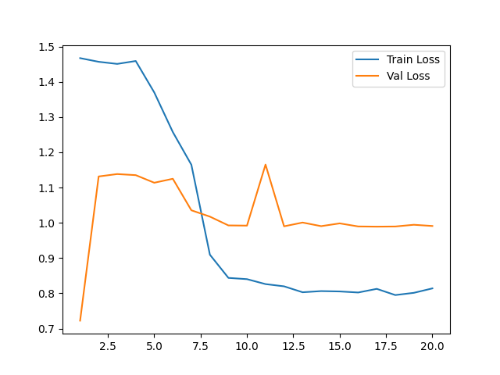
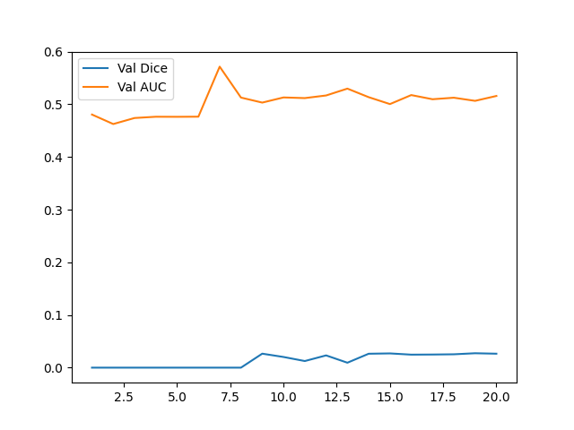
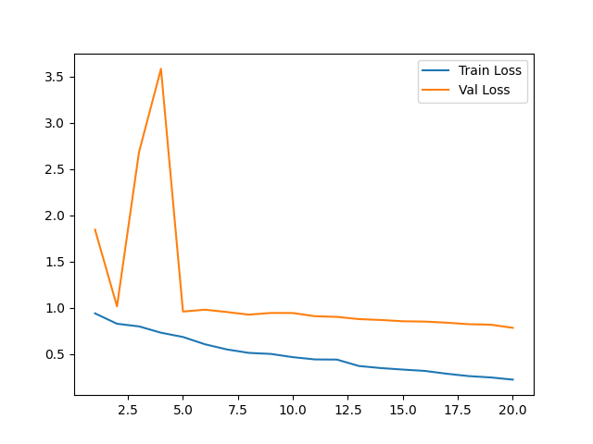
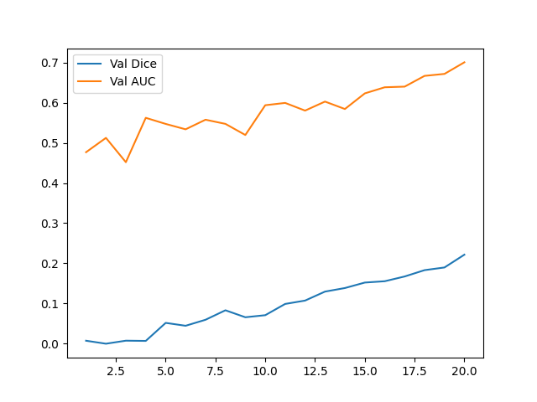
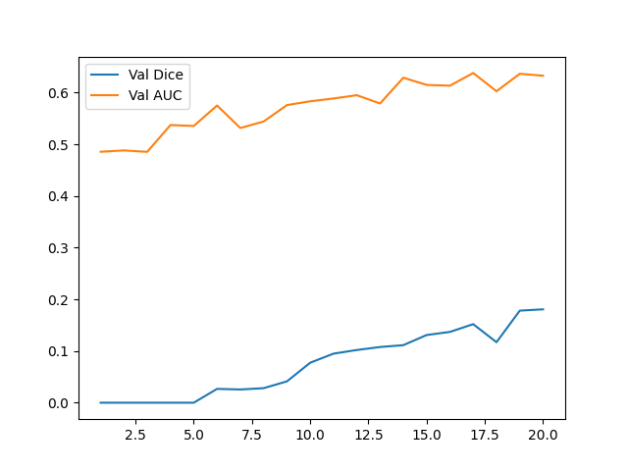
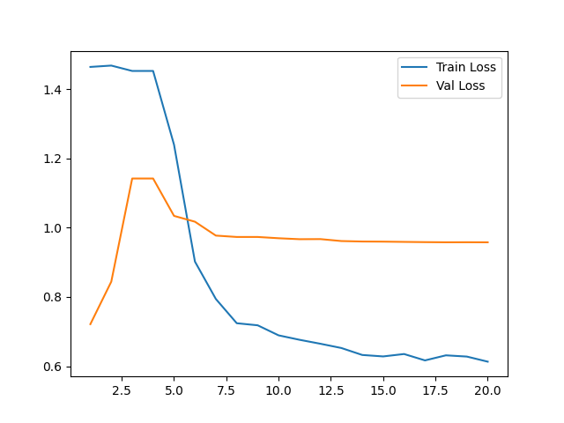
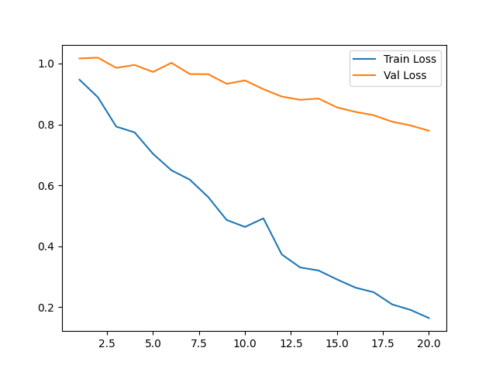
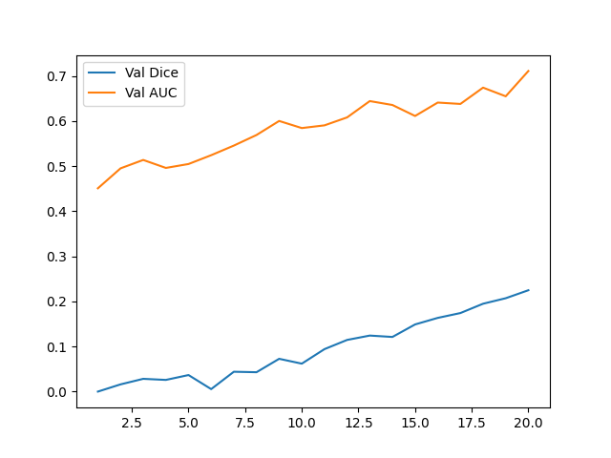
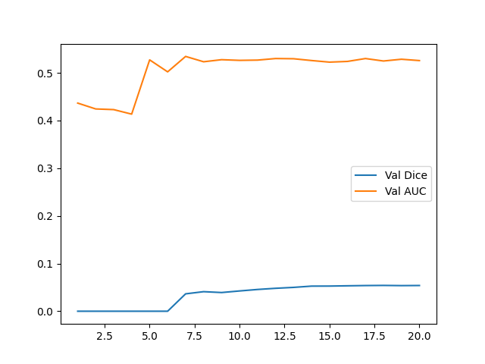
Segmentation Results with Original and Synthetic Tumors (2/2)

Slide 5
Results Comparison
Applied Attention U-Net on LiTS dataset using Stratified K-Fold Cross-Validation
Evaluated the model using a test set of 30 images out of which 8 didn’t had tumor in it
 | Model Trained On Original Images (Trained on 130 Images) |  | Model Trained On Synthetic Images (Trained on 80 Images) |  | Model Trained On Original + Synthetic Images (Trained on 108 Images)
 | Train (Avg. of all folds) | Test | Train (Avg. of all folds) | Test | Train (Avg. of all folds) | Test
Accuracy | 98% | 92% | 92% | 87% | 70% | 69%
Dice Coefficient | 0.47 | 0.44 | 0.85 | 0.26 | 0.58 | 0.24
Sensitivity | 0.76 | 0.99 | 0.87 | 0.67 | 0.62 | 0.65
Specificity | 0.79 | 0.91 | 0.92 | 0.88 | 0.87 | 0.86
AUC | 0.94 | 0.98 | 0.90 | 0.85 | 0.63 | 0.61

Slide 6
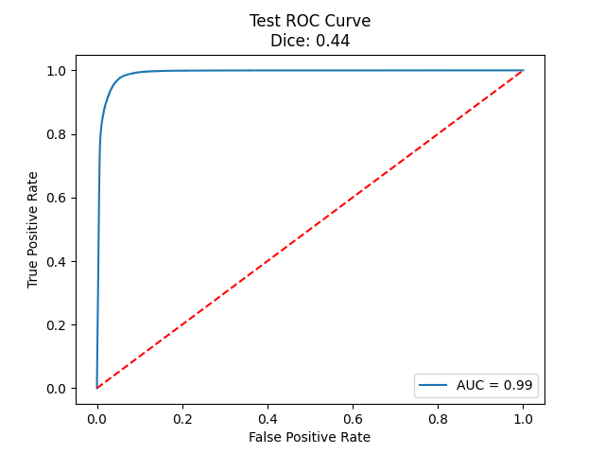
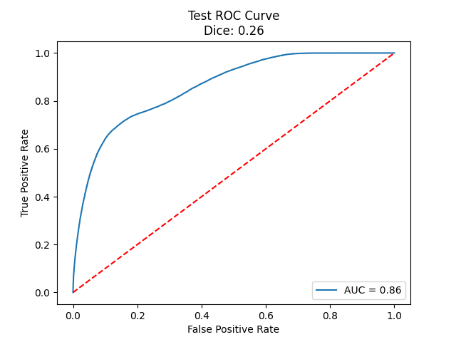
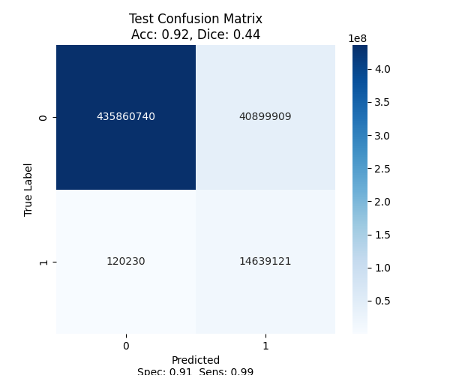
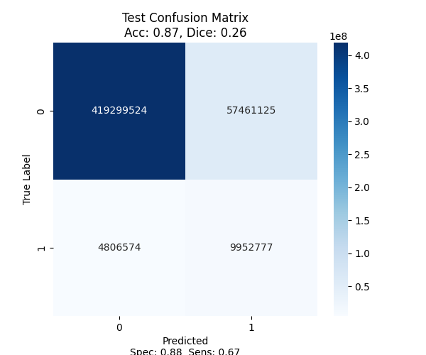
Results Comparison
Original Dataset
Synthetic Dataset

Slide 7
Next Steps
Compare segmentation accuracy and dice coefficient values from all slices original images
Compare test results for a model trained with both original and synthetic images
Check all the evaluation metrics

Slide 8


Slide 9
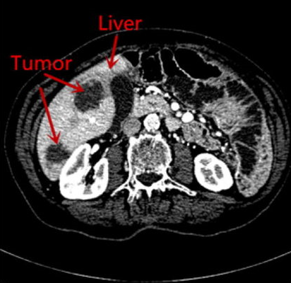
Introduction
Hepatocellular Carcinoma (HCC) is a fatal liver cancer with a 5-year survival rate of 21%
HCC Treatment procedure i.e., TACE is stressful and costly
CT scans enable accurate tumor response evaluation
Automatic tumor segmentation speeds up response assessment
Early detection is crucial due to high recurrence and treatment resistance

Slide 10
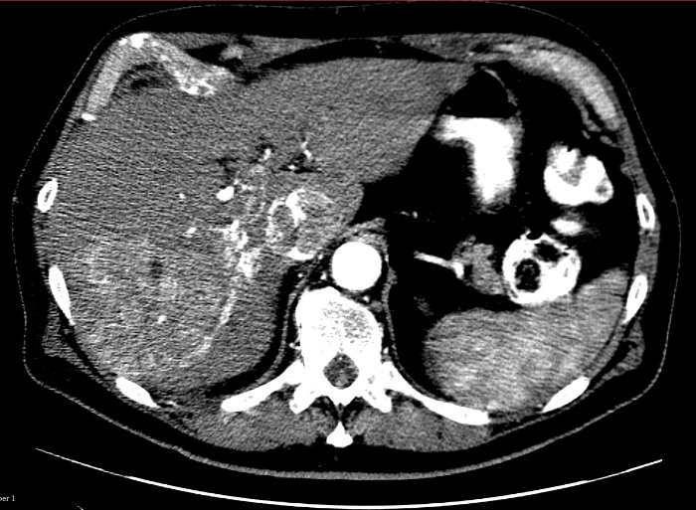
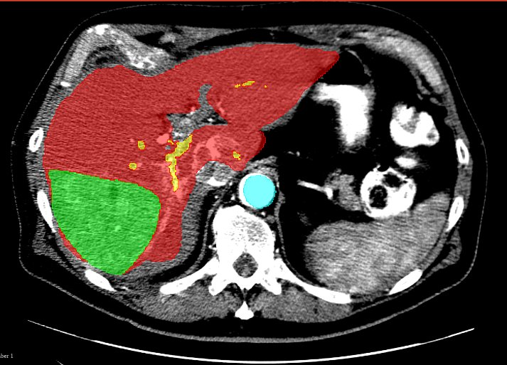
Current Challenges in Detection and diagnosis
Subtle boundaries make tissue distinction difficult
Tumors’ varying shapes and sizes complicate modeling
Manual tumor annotation is slow, delaying treatment
Reliable early detection methods are lacking
Limited data affects prediction accuracy
Liver
Tumor mass
Portal vein
Abdominal aorta

Slide 11
Limitations of Standard Approaches
Current ML and DL models rely on limited, annotated datasets [1] and may struggle with new data due to overfitting
They achieve about 95% accuracy in HCC prediction [2]
[1] https://doi.org/10.48550/arXiv.2303.14869
[2] https://doi.org/10.48550/arXiv.2311.11520

Slide 12
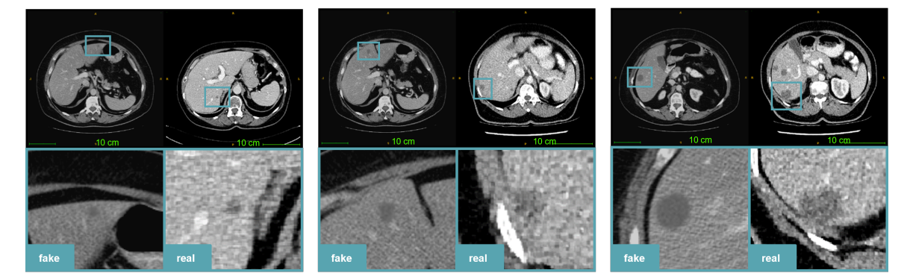
Potential of Generative AI
Generative AI (e.g., GANs, diffusion models) creates realistic synthetic medical images
Synthetic images support data augmentation, enhancing model generalization
Diverse synthetic images of early HCC improve early and accurate detection without the need of manual annotations
Training on synthetic images boosts model robustness, potentially raising accuracy above 95%

Slide 13
Literature Review
Author(s) | Category | Methodology | Findings | Limitations
Hu, Q., Chen, Y., Xiao, J., Sun, S., Chen, J., Yuille, A. L., & Zhou, Z. (2023) | Label-Free Tumor Segmentation + Synthetic Tumor Generation | Synthetic tumors were generated with shape, texture, and size variations, avoiding vessel collisions, evaluated with DSC and Visual Turing Test, and validated across datasets for robustness | Achieved DSC of 59.81%, surpassing real-data models (57.63%) Identified tumors as small Radiologists struggled to tell real and synthetic tumors apart | Struggled with extreme tumor sizes/intensities Model affected by imaging differences GANs or diffusion models could improve realism
Wu, L., Zhuang, J., Ni, X., & Chen, H. (2024) | AI-Driven Tumor Synthesis + Image Segmentation | Uses a GAN-based approach to dynamically synthesize tumors and filters low-quality ones using a trained segmentor as a discriminator, ensuring realistic placement within organ boundaries | Achieves 8.9% DSC gain, outperforming state-of-the-art methods Removes low-quality synthetic tumors Universal model outperforms specialized ones with large datasets | Limited to three tumor types (liver, pancreas, kidney) Performance gain plateaus beyond 6k cases. Stability issues with diverse datasets need further refinement
Liu, Y., Meng, L., & Zhong, J. (2021) | AI-Driven Tumor Synthesis | MAGAN (Mask Attention GAN) to synthesize liver CT images with tumors for dataset augmentation | Achieves 6.5% DSC gain Achieved PSNR of 64.72 dB Radiologists struggled to tell real and synthetic tumors apart | Minor color inconsistencies in tumors noted by radiologists Extendable to MR, PET, and other imaging types Training took ~10 hours, requiring significant resources

Slide 14
Segmentation Results without Synthetic Tumors (1/2)
Applied Attention U-Net on LiTS dataset using Stratified K-Fold Cross-Validation, incorporating Sobel edge detection on all slices to enhance boundary precision and improve segmentation performance (using 28 Samples)
Folds | Training Dice Coeff | Validation Dice Coeff | Testing Dice Coeff | Sensitivity | Specificity
1 | 0.74 | 0.74 | 0.75 | 0.95 | 0.99
2 | 0.04 | 0.04 | 0.04 | 1 | 0
3 | 0.73 | 0.71 | 0.73 | 0.97 | 0.99
4 | 0.83 | 0.83 | 0.83 | 0.89 | 0.99
5 | 0.04 | 0.04 | 0.04 | 0 | 1
Avg. Accuracy | Avg. Loss | Avg. Dice | Exec Time
98.37 (+- 0.48) | 0.87 | 0.47 | 98525.85 sec

Slide 15
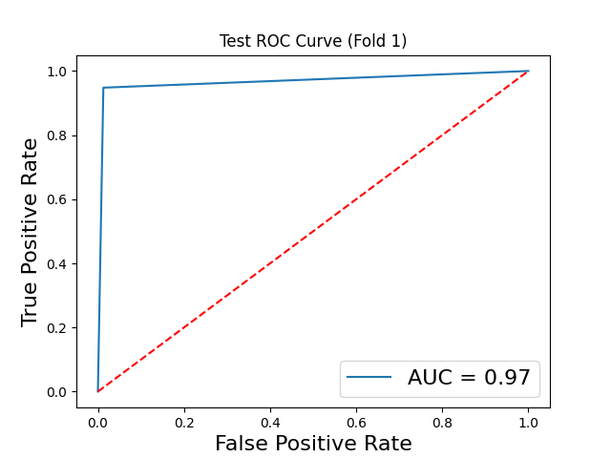
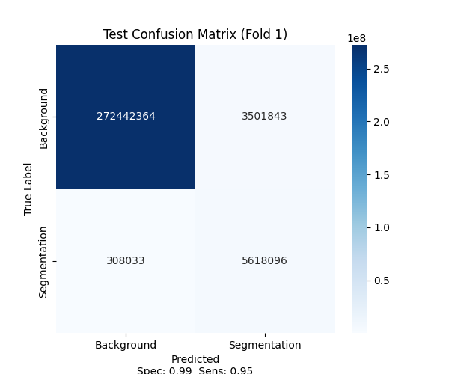
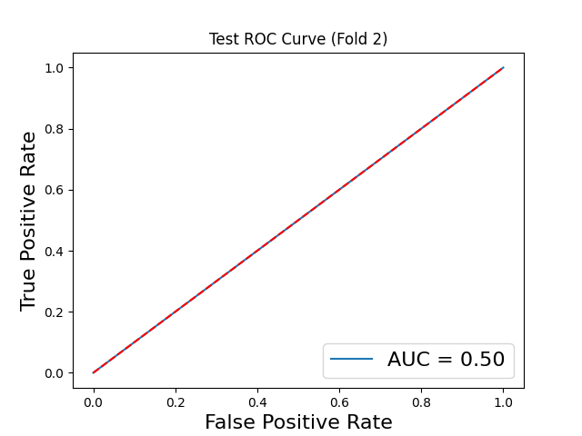
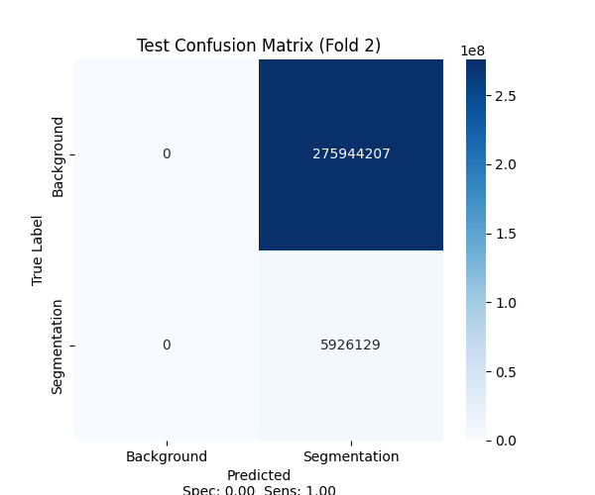

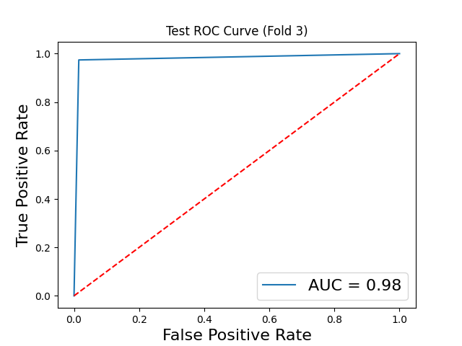

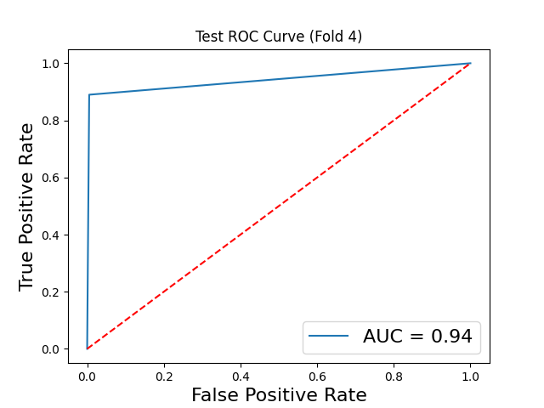
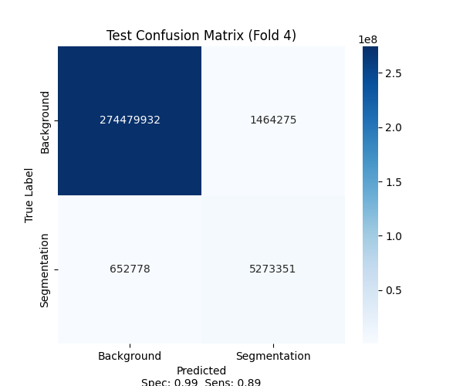
Segmentation Results - 28 Samples (2/2)

Slide 16
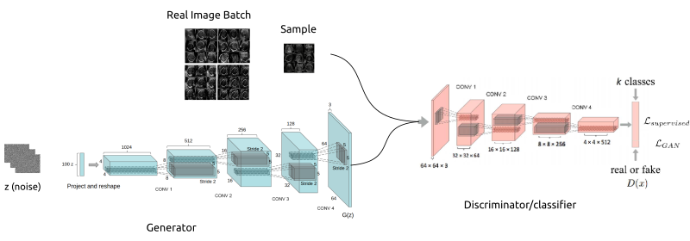
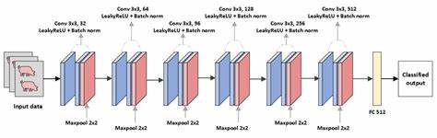
Methodology
DCGAN x 2
WGAN

Slide 17
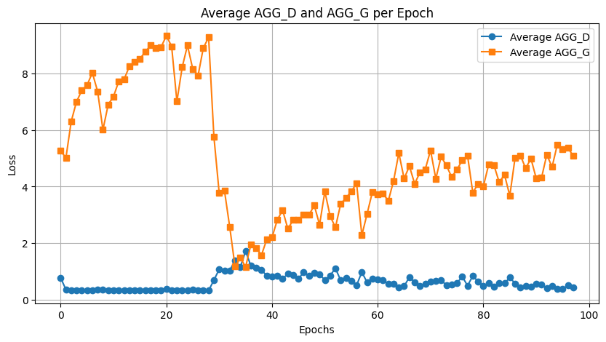
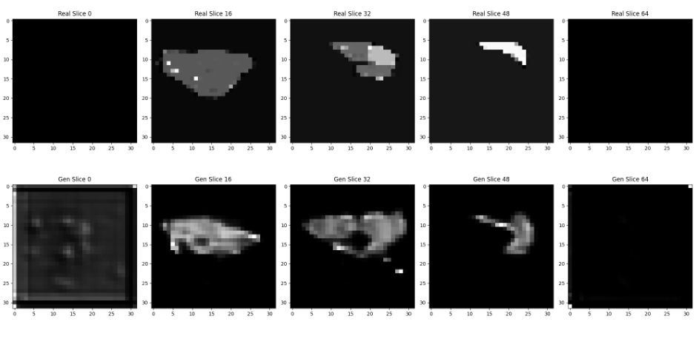
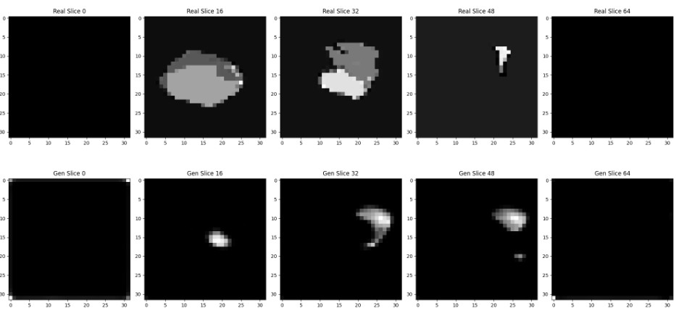
Results

Slide 18
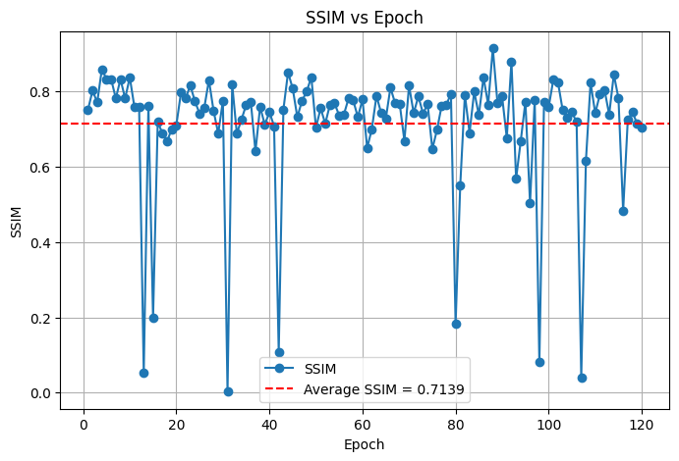
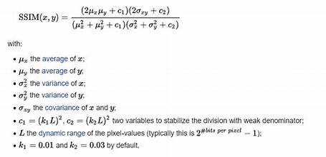
Synthetic Tumor Evaluation - SSIM
SSIM (Structural Similarity Index) is a perceptual metric for assessing image quality by comparing luminance, contrast, and structure between two images.
Its value ranges from 0 to 1, where 1 indicates perfect similarity and 0 indicates no similarity.

Slide 19
Synthetic Liver Tumor Image Generation Strategy
Identified healthy liver images from Lits Dataset with labels only 0 and 1 across the complete 3D image
Pick one random spot in the liver to be the center for the tumor
Check the size of the tumor and adjust its placement so it fits within the liver boundaries
Replace the liver tissue in that area with the tumor image and update the map to mark it as tumor

Slide 20
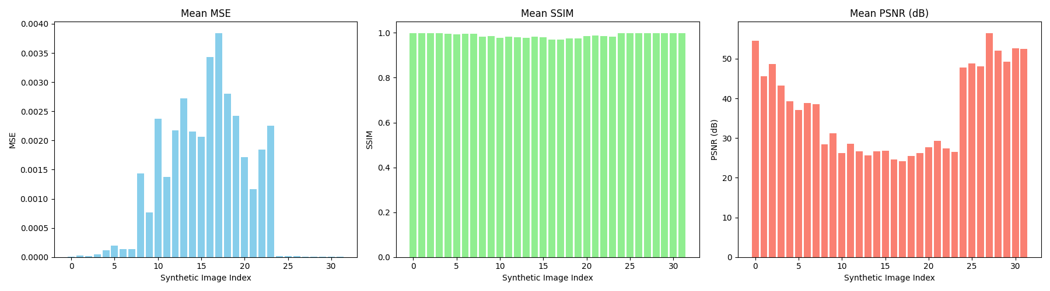
Synthetic Image Evaluation
Mean MSE is relatively low across volumes, indicating that the pixel-level error between predicted and ground truth slices is minimal
Mean SSIM remains consistently high, suggesting strong structural similarity and accurate reconstruction of shape and edges
Mean PSNR values are also high, reflecting a low level of noise and high fidelity in the predicted images

Slide 21
Segmentation Results without Synthetic Tumors (1/3)
Applied Attention U-Net on LiTS dataset using Stratified K-Fold Cross-Validation, incorporating Sobel edge detection on all slices to enhance boundary precision and improve segmentation performance considering top 300 slices
Folds | Training Dice Coeff | Validation Dice Coeff | Sensitivity | Specificity
1 | 0.76 | 0.62 | 0.51 | 0.99
2 | 0.07 | 0.06 | 0.03 | 0.99
3 | 0.71 | 0.68 | 0.56 | 0.99
4 | 0.69 | 0.66 | 0.96 | 0.96
5 | 0.44 | 0.43 | 0.99 | 0.89
Avg. Accuracy | Avg. Dice | Exec Time
95.20 | 0.49 | 22199.06 sec

Slide 22
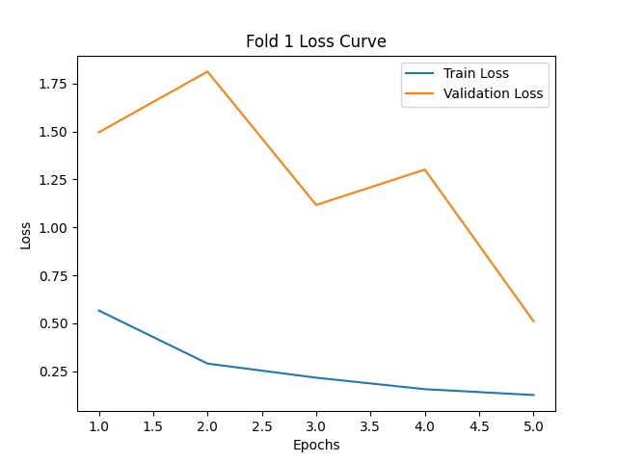
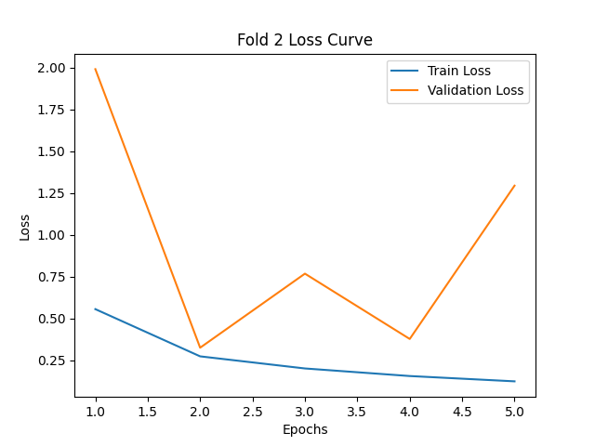
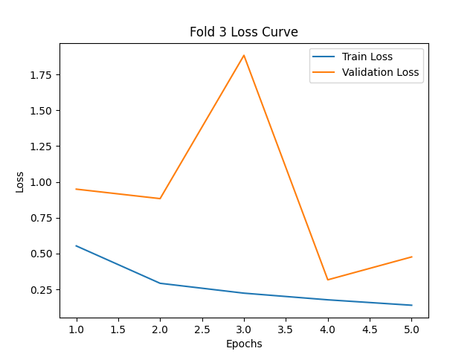
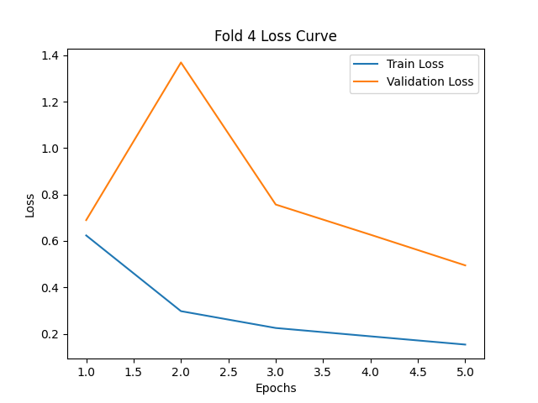
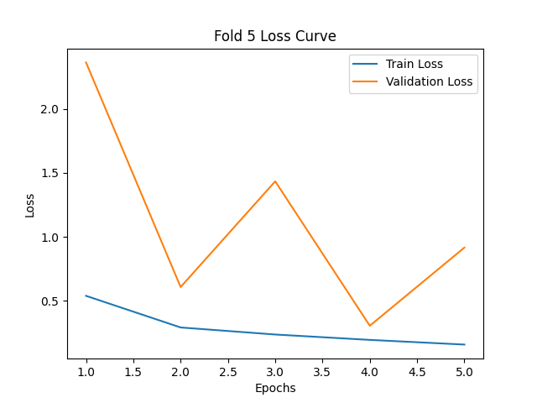
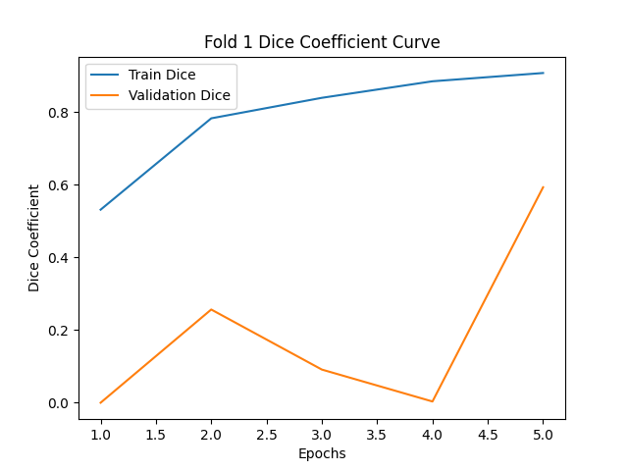
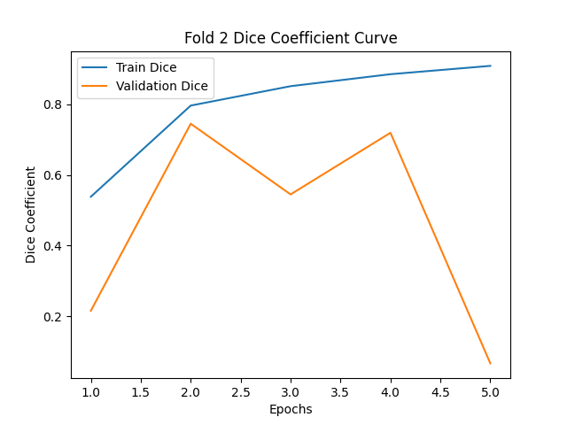
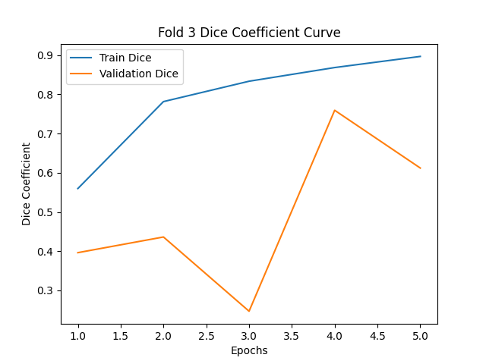
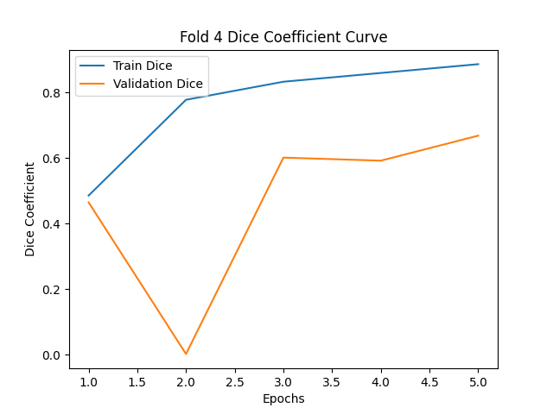
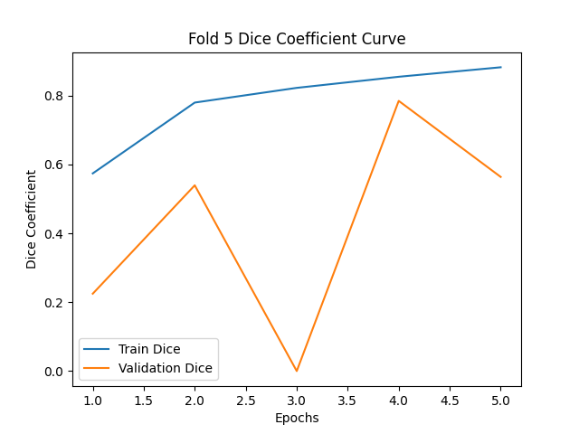
Segmentation Results – Loss & Dice Graph(2/3)

Slide 23
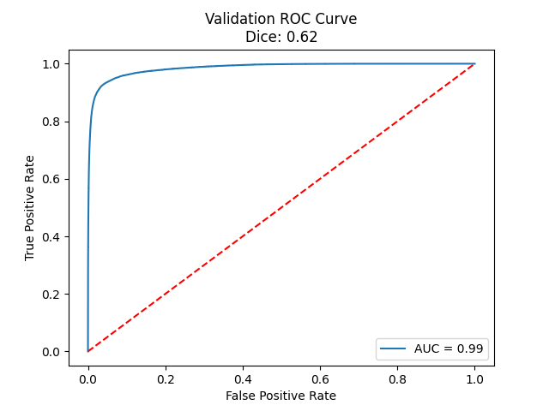
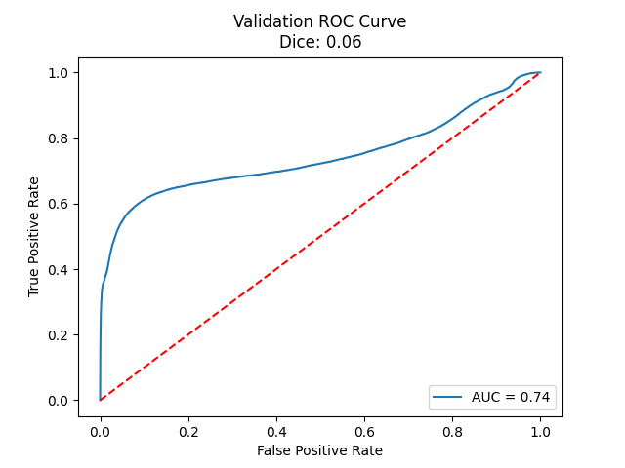
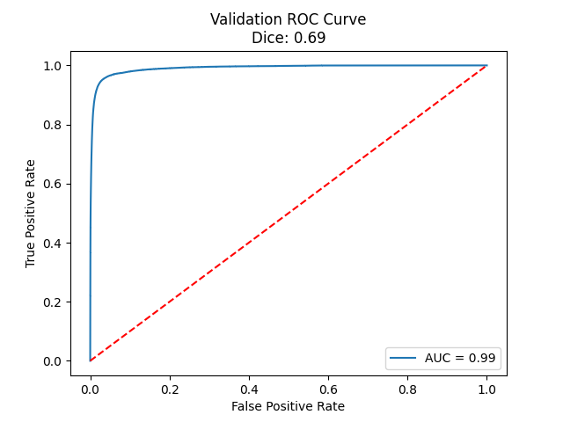
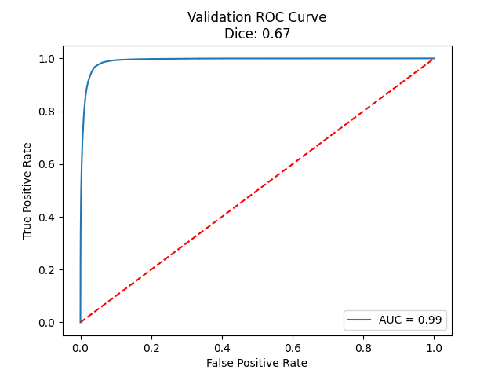
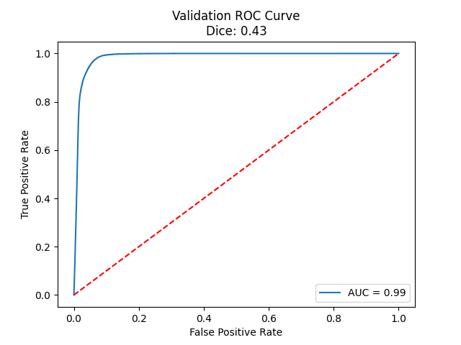
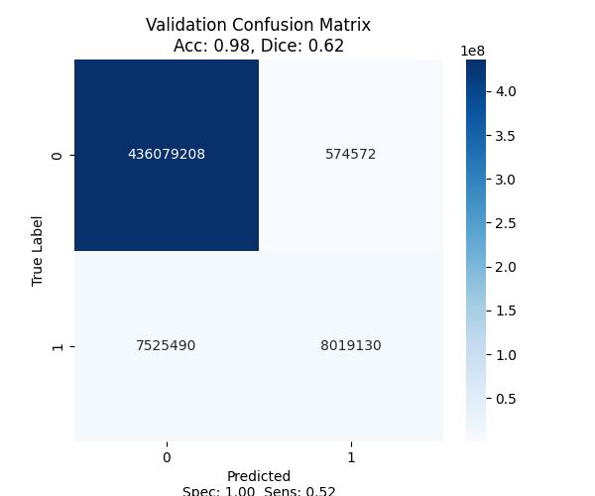


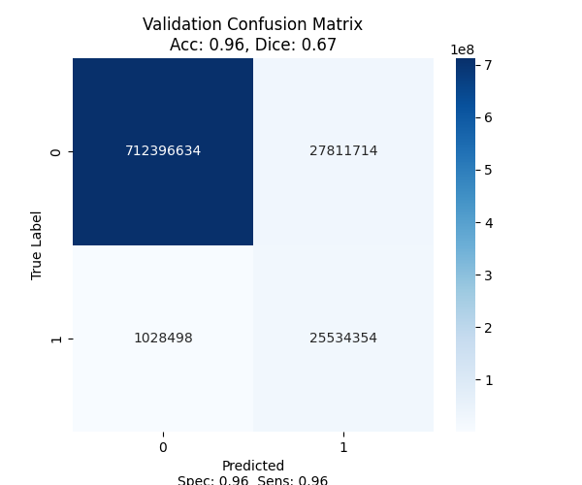
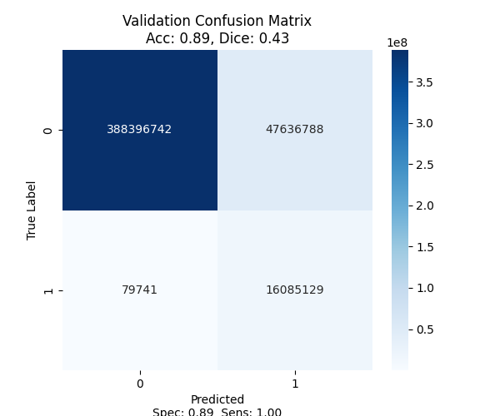
Segmentation Results – CM & AUC Curve(3/3)

Slide 24
Segmentation Results with Synthetic Tumors (1/3)
Applied Attention U-Net on synthetic dataset using Stratified K-Fold Cross-Validation, incorporating Sobel edge detection on all slices to enhance boundary precision and improve segmentation performance considering all slices
Folds | Training Dice Coeff | Validation Dice Coeff | AUC | Loss
1 | 0.99 | 0.96 | 0.91 | 0.64
2 | 0.97 | 0.91 | 0.82 | 0.85
3 | 0.99 | 0.99 | 0.98 | 0.50
4 | 0.98 | 0.94 | 0.95 | 0.69
5 | 0.80 | 0.71 | 0.83 | 2.32
Avg. Accuracy | Avg. Dice | Exec Time
91.80 | 0.90 | 6760.69 sec

Slide 25










Segmentation Results – Loss & Dice Graph(2/3)

Slide 26










Segmentation Results – CM & AUC Curve(3/3)

